Slide 1

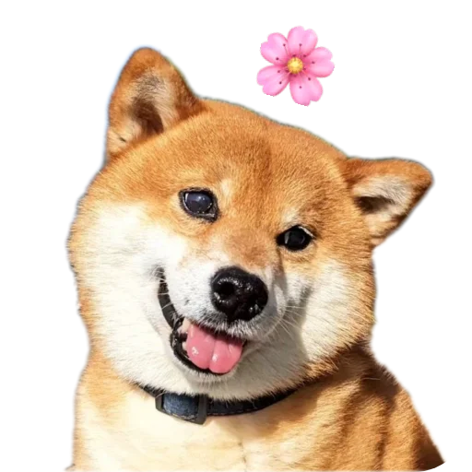
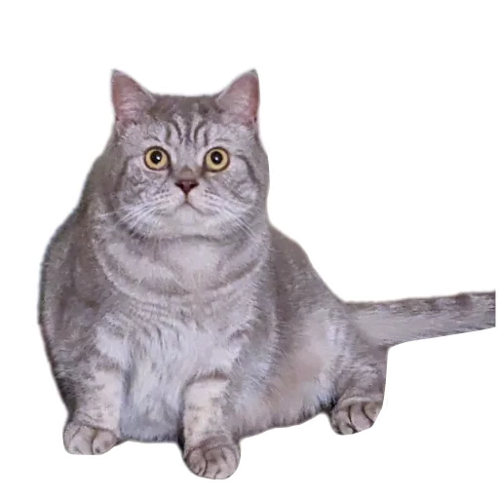




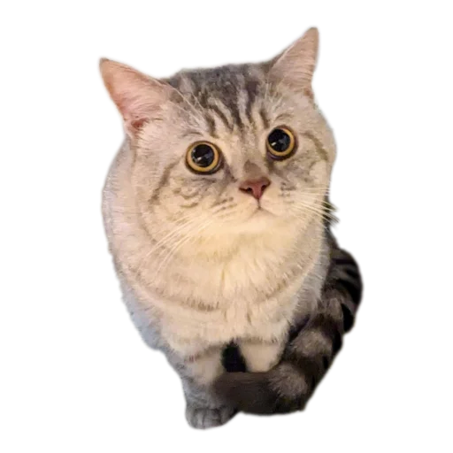
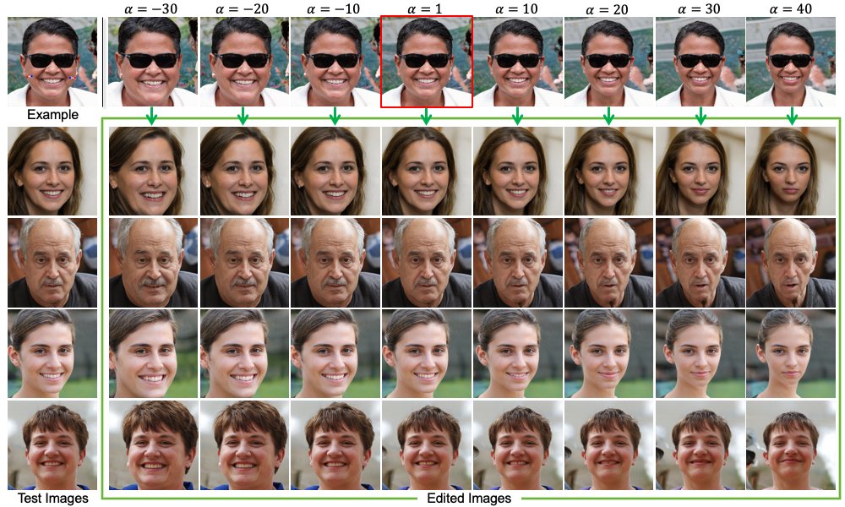
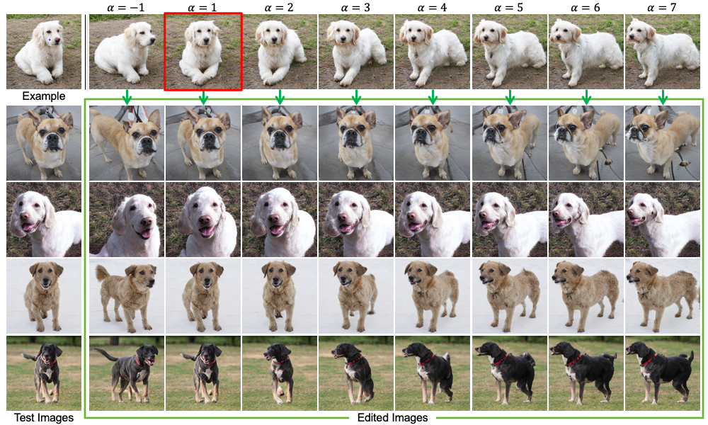
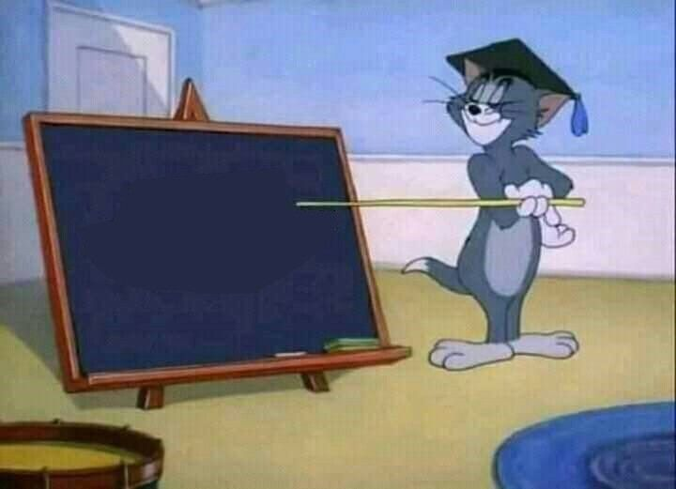
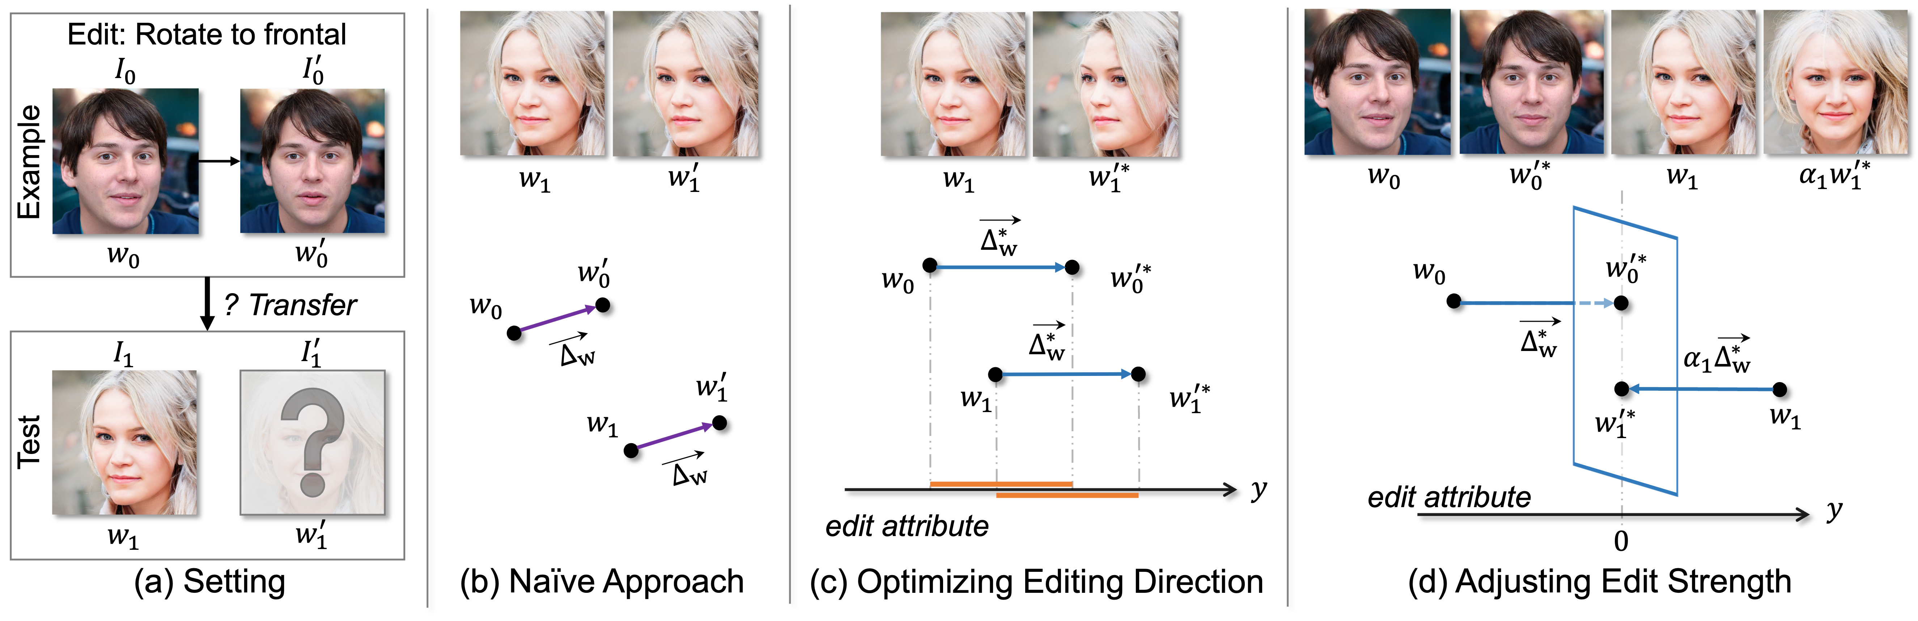
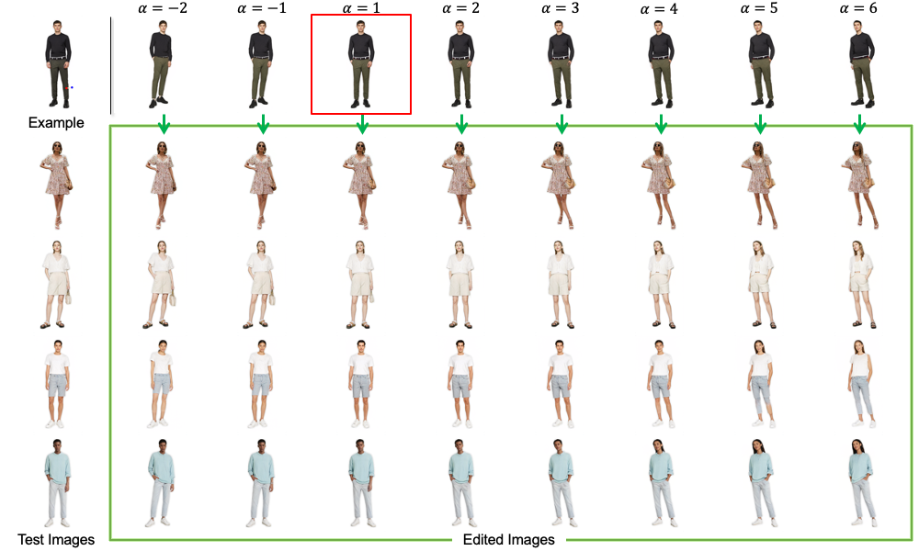
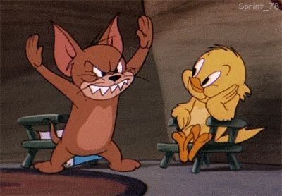
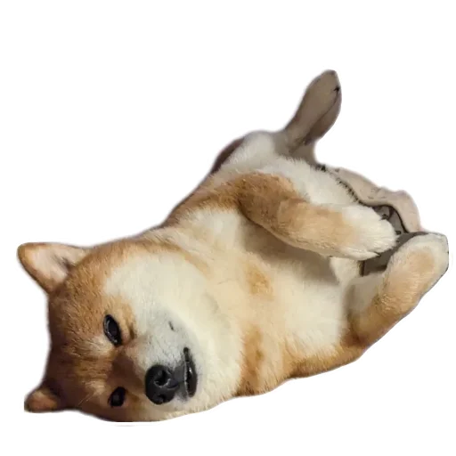
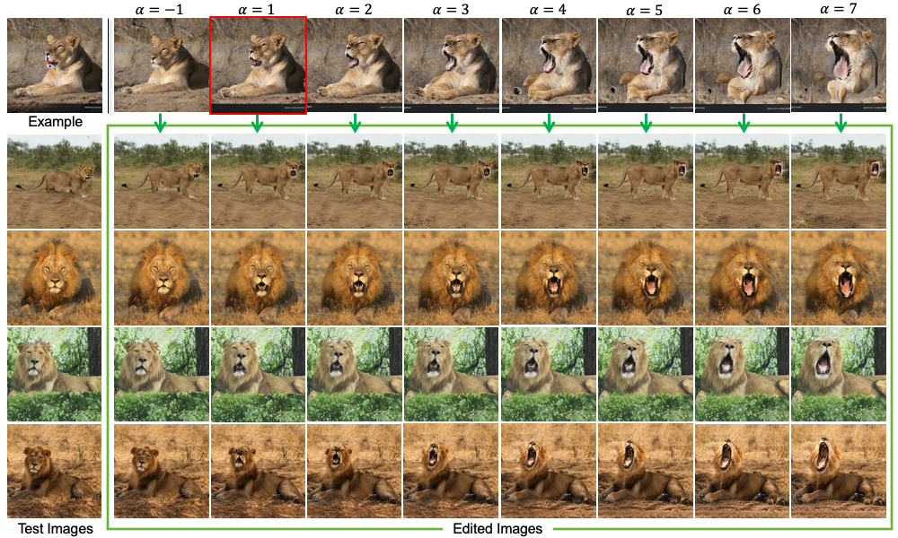
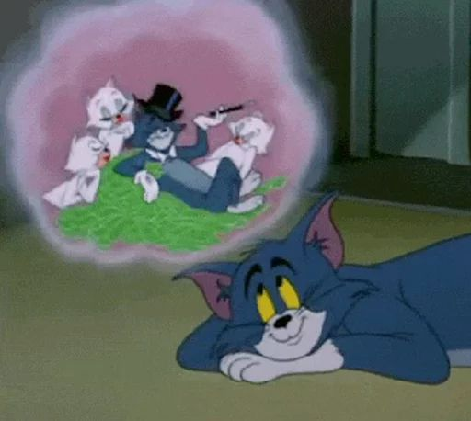
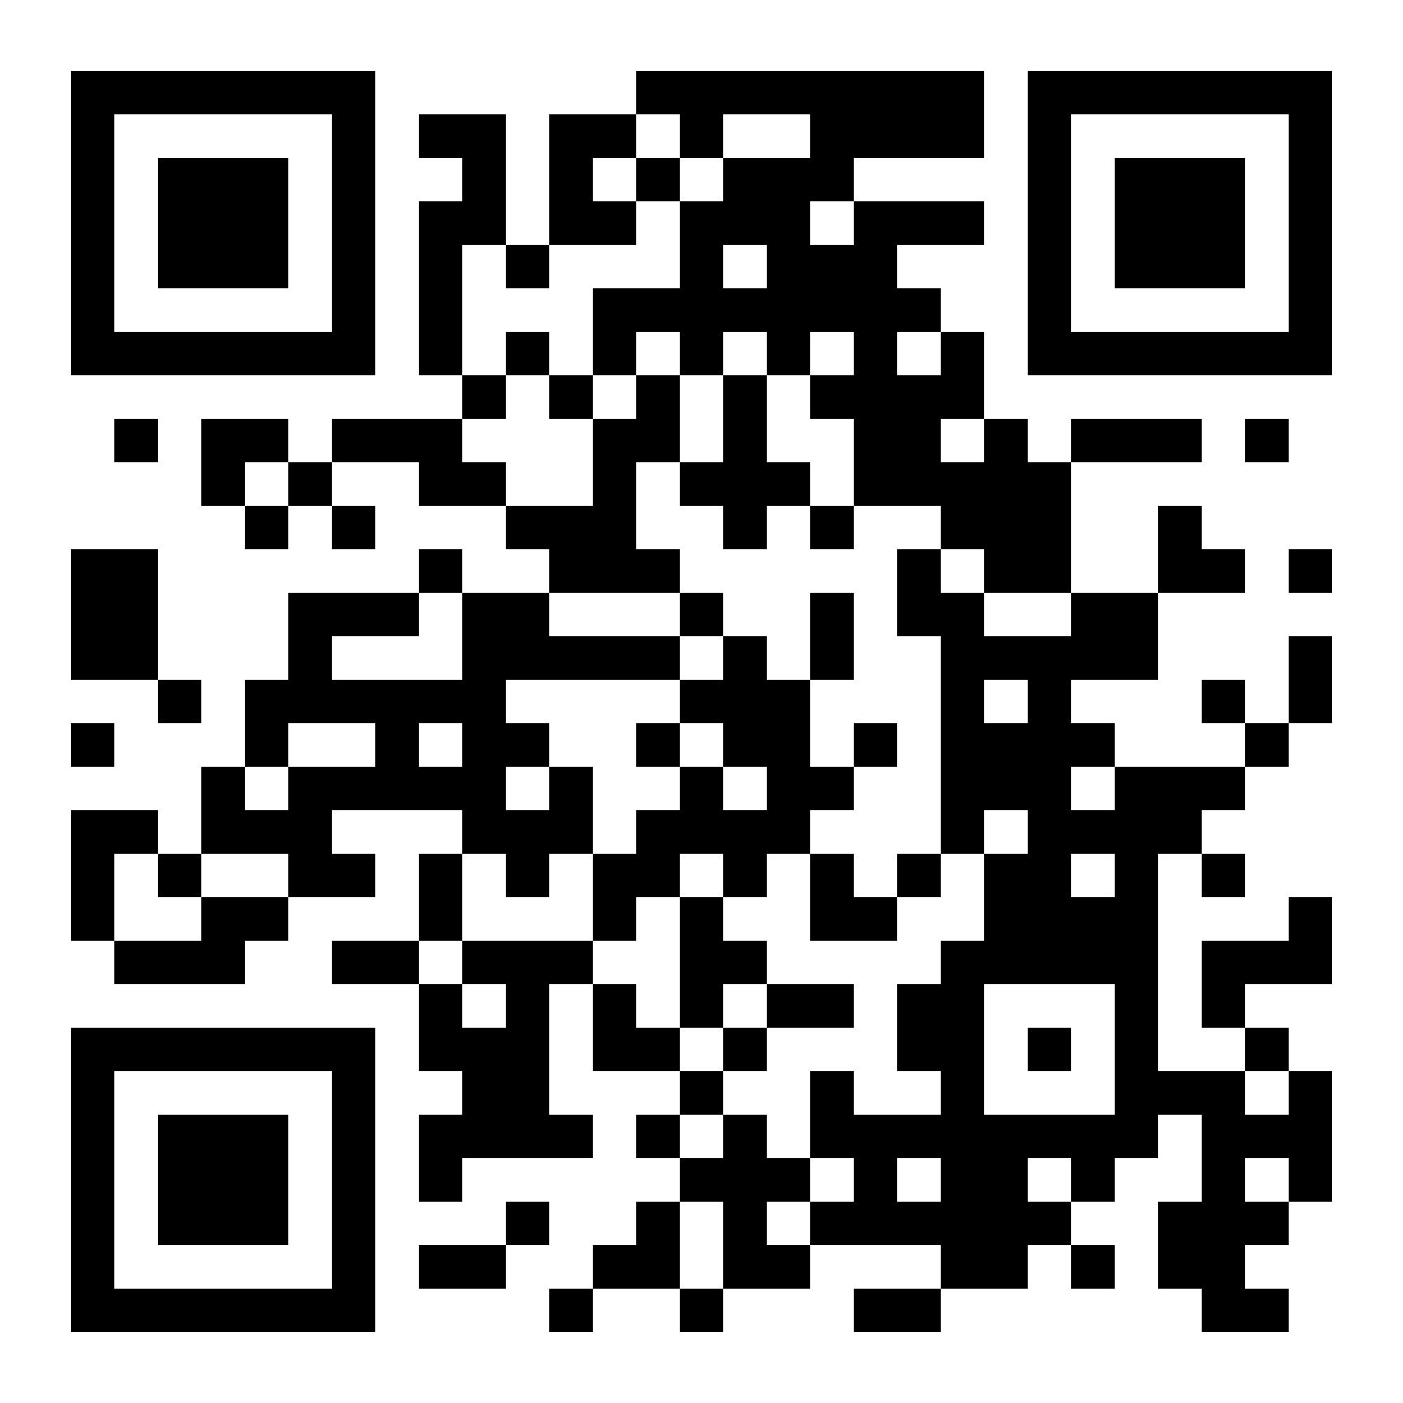
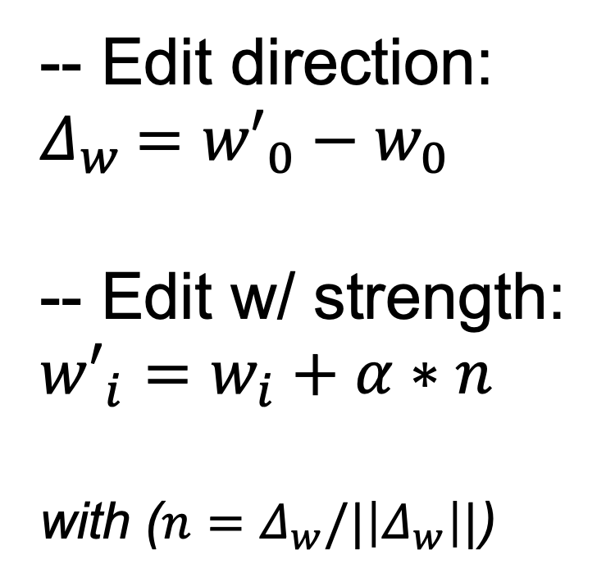
Edit One for All: Interactive Batch Image Editing
?
Add my Wechat!
Thao Nguyen Utkarsh Ohja Yuheng Li Haotian Liu Yong Jae Lee
🦡 University of Wisconsin—Madison
“How to edit multiple imgs fast & consistent all together?”
-ˋˏ✎ ── Gallery
Thao is looking for summer internship 2025!
please~
-ˋˏ✎ ── Problem Statement
increase editing strength
edit
one
how to edit batches
of images
auto-
transfer
to others!
-ˋˏ✎ ── Approach
StyleGAN + Adaptive Editing Strength!
*author explain approach
*CVPR audience
-- Edit direction:
$Δ_{w}$ $={w′}_{0}−w_{0}$
-- Edit w/ strength:
$${w′}_{i}=w_{i}+α∗n$$ with ($n=Δ_{w}/|\left|Δ_{w}\right||$)
final-state consistent
-ˋˏ✎ ── What’s next?
zzz
🏅 best paper🏅
Extend to diffusion-based models? 🤔
How do we define 'consistency' for free-form edits? 📝
Across-domain transfer? (e.g., human 👱 → dog 🐶)
You name it 🙋‍♀️
*new project idea
“Editing one image is cool…
But editing multiple images is next-level 😎 💯 💥”
For more, visit: https://thaoshibe.github.io/ 🌱 !

